Slide 1


Slide 2
Domain: Consumer Goods | Function: Executive Management Atliq Hardwares (imaginary company) is one of the leading computer hardware producers in India and well expanded in other countries too. However, the management noticed that they do not get enough insights to make quick and smart data-informed decisions. They want to expand their data analytics team by adding several junior data analysts. Tony Sharma, their data analytics director wanted to hire someone who is good at both tech and soft skills. Hence, he decided to conduct a SQL challenge which will help him understand both the skills. Task: Imagine yourself as the applicant for this role and perform the following task 1. Check ‘ad-hoc-requests.pdf’ - there are 10 ad hoc requests for which the business needs insights. 2. You need to run a SQL query to answer these requests. 3. The target audience of this dashboard is top-level management - hence you need to create a presentation to show the insights. 4. Be creative with your presentation, audio/video presentation will have more weightage.
Problem Statement

Slide 3
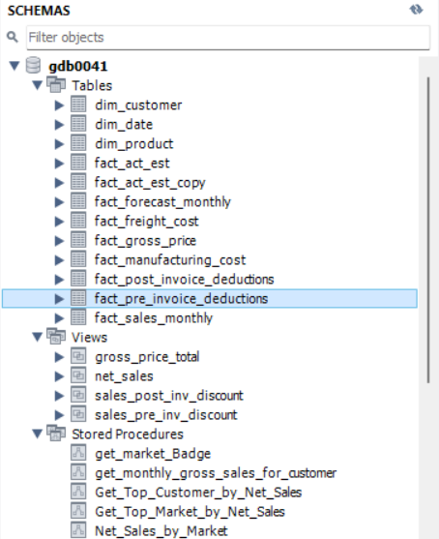


These Datas are provided by AtliQ Management
Views allow you to save and reuse complex SELECT statements, making it easier to query large datasets without repeating the same logic.
A stored procedure in MySQL is a precompiled set of SQL statements that encapsulates business logic, enhances reusability, performance, security, and maintainability, and reduces network traffic.
A function in MySQL is a stored program that returns a single value and can be used in SQL statements, providing reusability, modularity, and the ability to encapsulate logic for calculations or data manipulations.

Slide 4
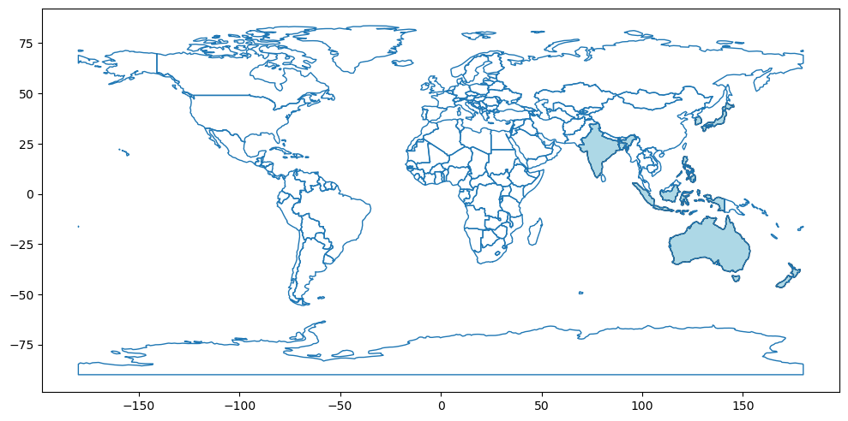
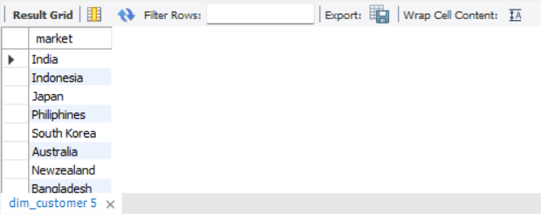
Query:-1 List of markets in which customer "Atliq Exlcusive" operates business in the APAC region.
SELECT
distinct market
FROM dim_customer
where region = "APAC"
and customer= "Atliq Exclusive";

Slide 5
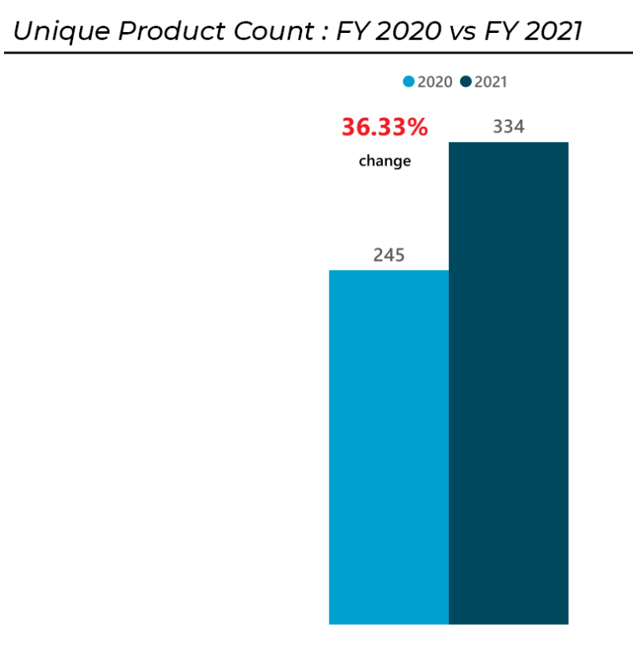
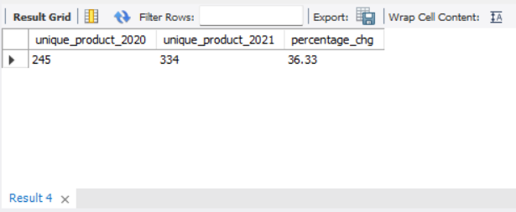
Query:-2 What is the percentage of unique product increase in 2021 vs 2020?
select A.total_product as unique_product_2020,
B.total_product as unique_product_2021,
round((B.total_product - A.total_product) * 100.0 / A.total_product, 2) as percentage_chg
from
(select count(distinct(product_code)) as total_product from fact_sales_monthly where fiscal_year = 2020) A,
(select count(distinct(product_code)) as total_product from fact_sales_monthly where fiscal_year = 2021) B;
Findings:
Product count increased by 36% in FY 2020 to 2021
Increase of product count may cause of increase gross sales

Slide 6
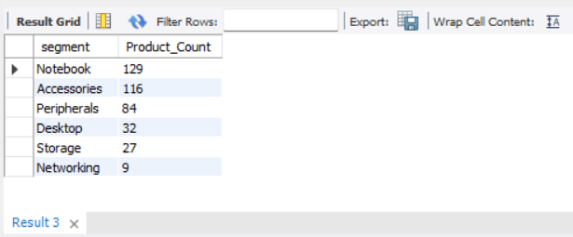
Query:-3 Provide a report with all the unique product counts for each segment and sort them in descending order of product counts.
select
segment,
count(distinct(product_code) ) as Product_Count
from dim_product
group by segment
order by Product_Count desc;

Slide 7
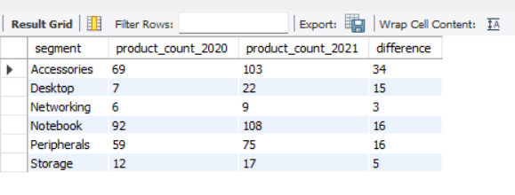
Which segment had the most increase in unique products in 2021 vs 2020?
Query:-4
WITH cte1 AS
( SELECT P.segment, COUNT(DISTINCT S.product_code) AS product_count_2020
FROM fact_sales_monthly S
JOIN dim_product P
ON S.product_code = P.product_code
WHERE fiscal_year = 2020
GROUP BY P.segment),
cte2 AS
( SELECT P.segment, COUNT(DISTINCT S.product_code) AS product_count_2021
FROM fact_sales_monthly S
JOIN dim_product P ON S.product_code = P.product_code
WHERE fiscal_year = 2021
GROUP BY P.segment)
SELECT
cte1.segment,
cte1.product_count_2020,
cte2.product_count_2021,
cte2.product_count_2021- cte1.product_count_2020 as difference
FROM cte1 JOIN cte2 ON cte1.segment = cte2.segment;
In 2021, the product count increased across all segments compared to 2020. Accessories saw the highest growth with an additional 34 products, while Storage had the smallest increase of 5 products. Overall, the Notebook and Accessories segments experienced the most significant gains.

Slide 8
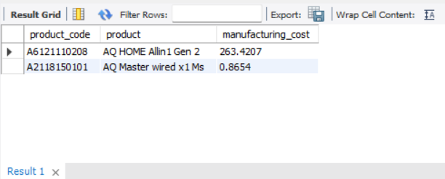
Get the products that have the highest and lowest manufacturing costs.
Query:-5
SELECT m.product_code,
p.product,
m.manufacturing_cost
FROM fact_manufacturing_cost m
join dim_product p
on m.product_code=p.product_code
where m.manufacturing_cost =
( select max(manufacturing_cost) from fact_manufacturing_cost)
Union
SELECT m.product_code,
p.product,
m.manufacturing_cost
FROM fact_manufacturing_cost m
join dim_product p
on m.product_code=p.product_code
where m.manufacturing_cost =
(select min(manufacturing_cost) from fact_manufacturing_cost)

Slide 9
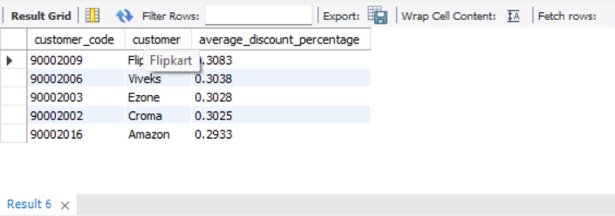
Generate a report which contains the top 5 customers who received an average high pre_invoice_discount_pct for the fiscal year 2021 and in the Indian market.
Query:-6
SELECT p.customer_code,
c.customer,
round(AVG(p.pre_invoice_discount_pct),4) AS average_discount_percentage
FROM fact_pre_invoice_deductions p
join dim_customer c
on p.customer_code=c.customer_code
where market="India"
and fiscal_year = 2021
group by p.customer_code, c.customer
order by average_discount_percentage desc
limit 5

Slide 10
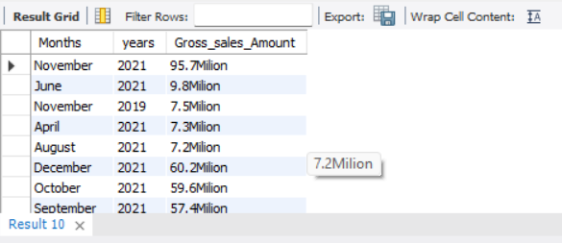
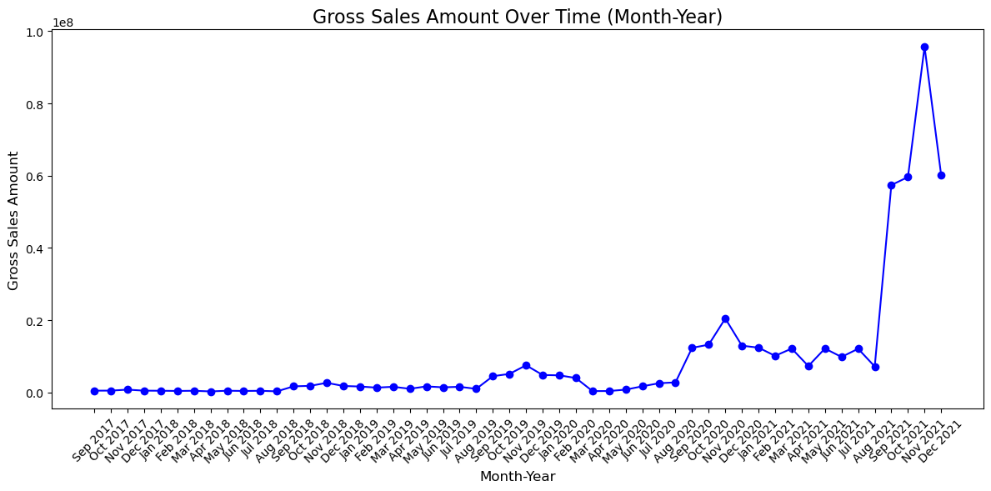
Get the complete report of the Gross sales amount for the customer “AtliqExclusive” for each month. This analysis helps to get an idea of low and high-performing months and take strategic decisions.
Query:-7
with cte as
(SELECT monthname(s.date) as Months,
year(s.date) as years,
s.sold_quantity*g.gross_price as total_gross_price,
s.fiscal_year
FROM fact_sales_monthly s
join fact_gross_price g
on s.product_code=g.product_code
and s.fiscal_year = g.fiscal_year
join dim_customer c
on s.customer_code=c.customer_code
where c.customer = "Atliq Exclusive")
select
Months,
years,
concat(round(sum(total_gross_price)/1000000 , 1),'Milion’)
as Gross_sales_Amount
from cte
group by Months,years
Order by Gross_sales_Amount desc ;
Findings:-
The line chart reveals a strong upward trend in gross sales from 2017 to 2021, with notable peaks in November, especially in 2021. Seasonal patterns are evident, with end-of-year months driving higher sales.

Slide 11
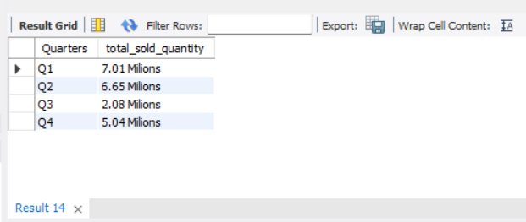
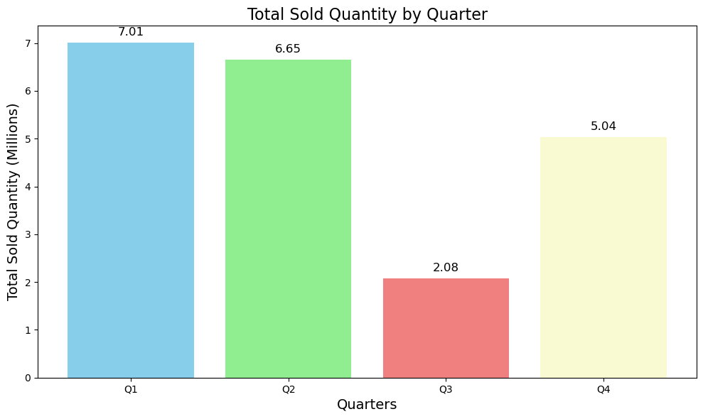
In which quarter of 2020, got the maximum total_sold_quantity?
Query:-8
SELECT
case
when month(date) between 9 and 11 then'Q1'
when month(date) in( 12 ,1 ,2) then'Q2'
when month(date) between 3 and 5 then 'Q3'
when month(date) between 6 and 8 then 'Q4’
end as Quarters,
concat(round(sum(sold_quantity)/1000000,2), ' Milions') as total_sold_quantity
FROM fact_sales_monthly
where fiscal_year = 2020
group by quarters;
Findings:-
The bar chart shows that Q1 had the highest total sold quantity at 7.01 million units, while Q3 had the lowest at 2.08 million units. Overall, sales were strongest in the first quarter and weakest in the third quarter.

Slide 12
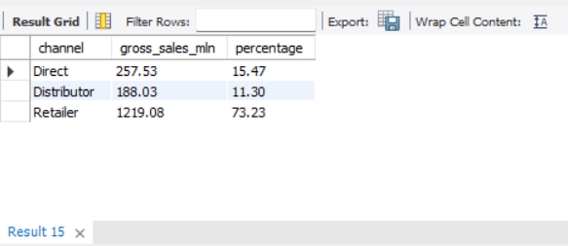
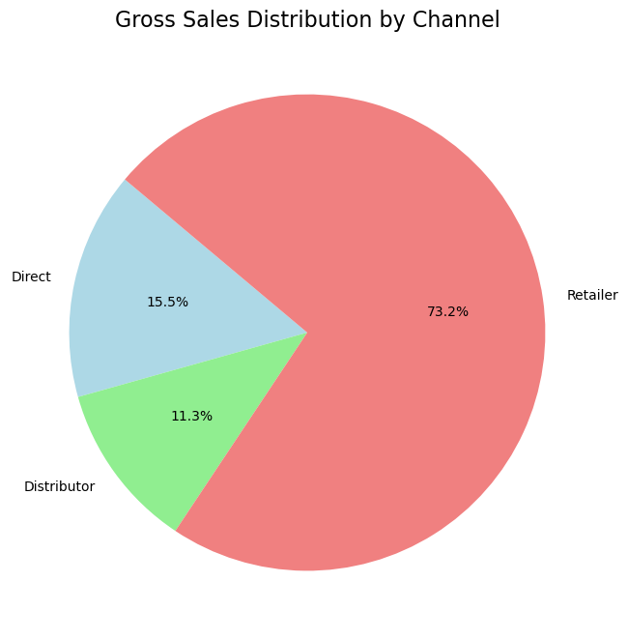
Which channel helped to bring more gross sales in the fiscal year 2021and the percentage of contribution?
Query:-9
with cte as (
select
channel,
round(sum((sold_quantity*gross_price)/1000000),2)
as gross_sales_mln
from fact_sales_monthly s
join fact_gross_price g
on s.product_code =g.product_code
and s.fiscal_year = g.fiscal_year
join dim_customer c
on s.customer_code=c.customer_code
where s.fiscal_year=2021
group by channel )
select
channel,
gross_sales_mln,
round(gross_sales_mln/(select sum(gross_sales_mln) from cte)*100,2) as percentage
from cte
Insights
Retailers dominate gross sales with 73.23% of the total, significantly outpacing Direct (15.47%) and Distributor (11.3%) channels. This indicates that the Retailer channel is the primary driver of sales revenue.

Slide 13
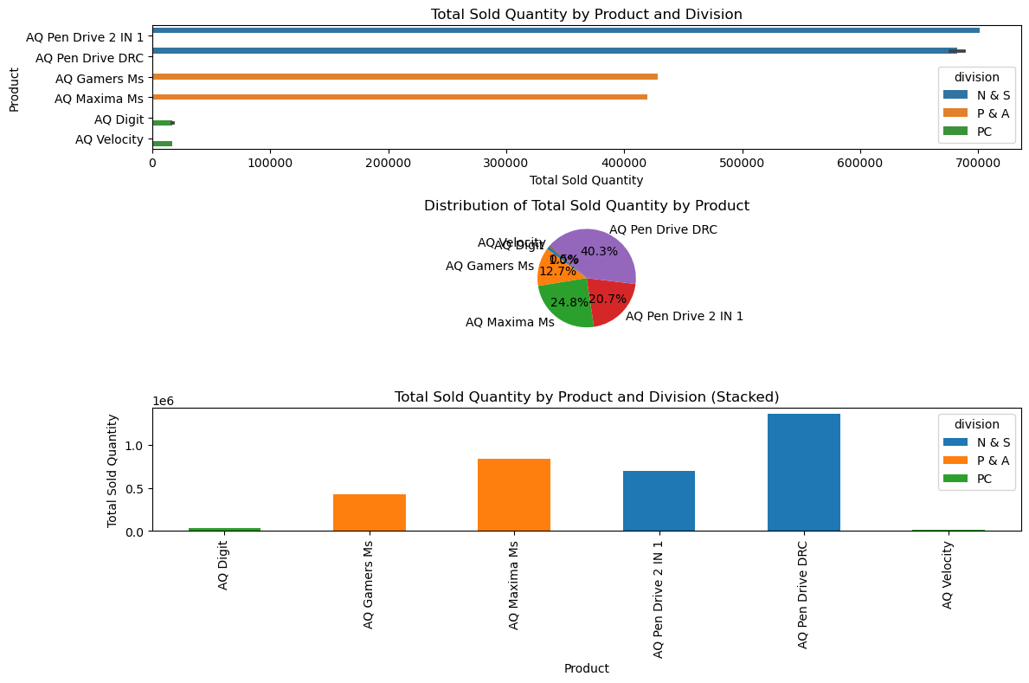
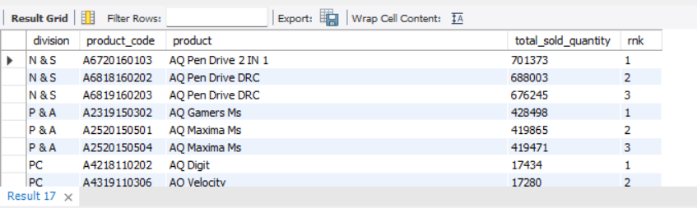
Get the Top 3 products in each division that have a high total_sold_quantity in the fiscal_year 2021?
Query:-10
with cte as (
select
p.division,
s.product_code,
p.product,
sum(s.sold_quantity) as total_sold_quantity,
dense_rank() over(partition by p.division order by sum(s.sold_quantity) desc) as rnk
from fact_sales_monthly s
join dim_product p
on s.product_code=p.product_code
where fiscal_year = 2021
group by division,s.product_code,product
)
select * from cte
where rnk <=3
Insights:-
The AQ Pen Drive 2 IN 1 product has the highest total quantity sold, particularly in the 'N & S' division. The AQ Digit product shows a strong presence across divisions, with notable sales in 'PC'. Overall, 'N & S' is the leading division in terms of total sales volume.

